Slide 1
Interim presentation thesis Daniel Fischer
TU Dresden
Chair of Transport Processes at Interfaces
11.11.2022

Slide 2
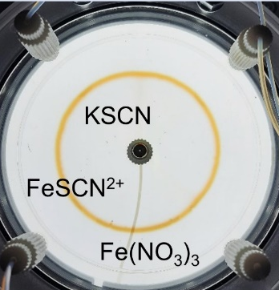
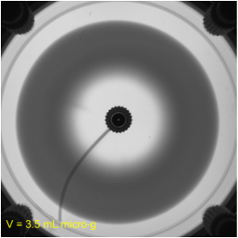
Motivation
model creation for experiments done in a Hele-Shaw cell with radial geometry

Slide 3
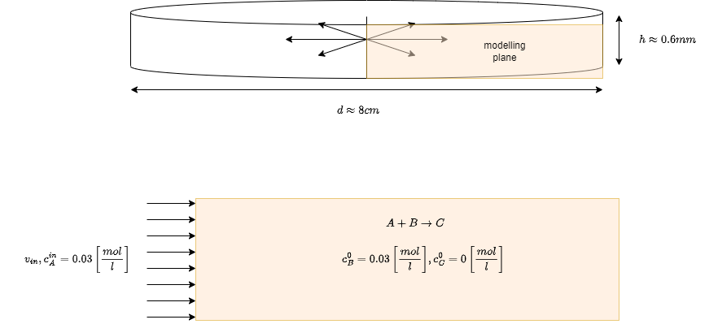
Model Setup
upper wall
inlet
lower wall
oulet

Slide 4
Cases
3 different heights
  0.2 mm | 0.4 mm | 0.6 mm
3 different Pe Numbers
  500 | 931 | 2048
2 different Sc Numbers
  1219 | ~ 1.2e4
18 different cases

Slide 5
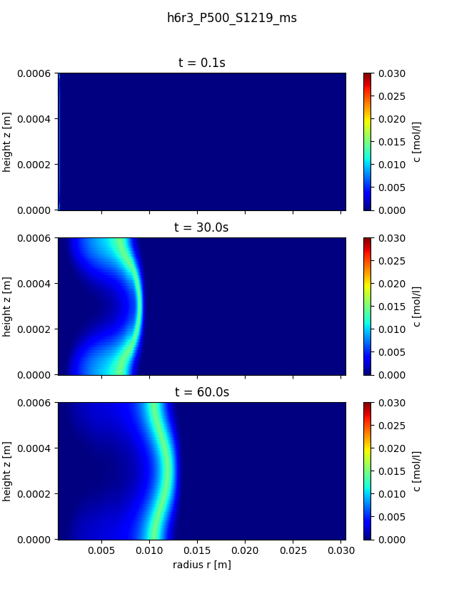
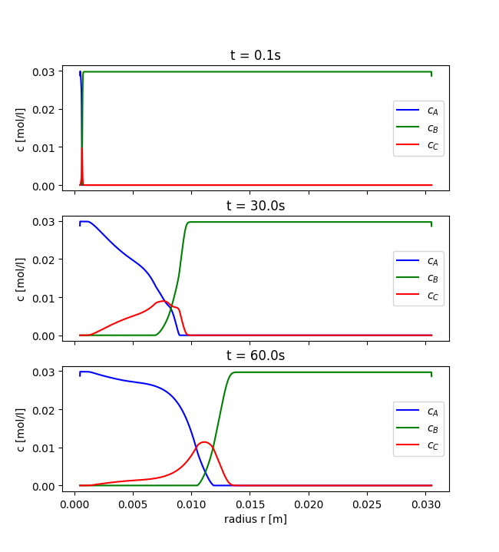
Simulation Results

Slide 6
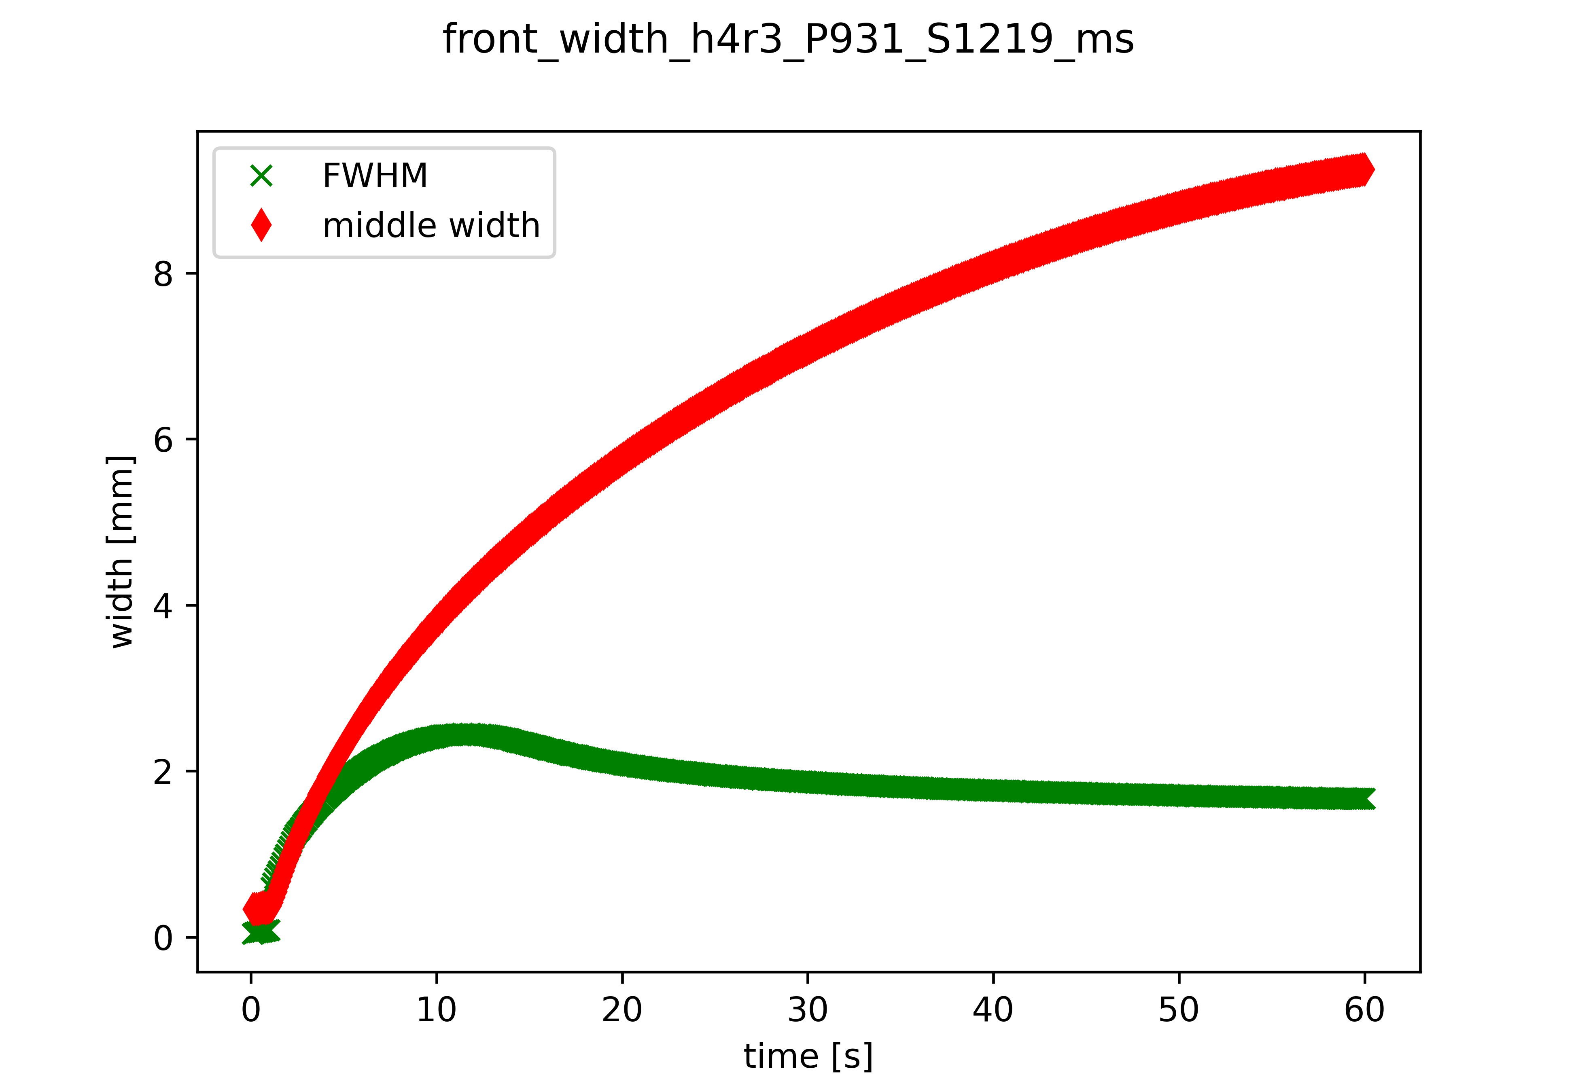
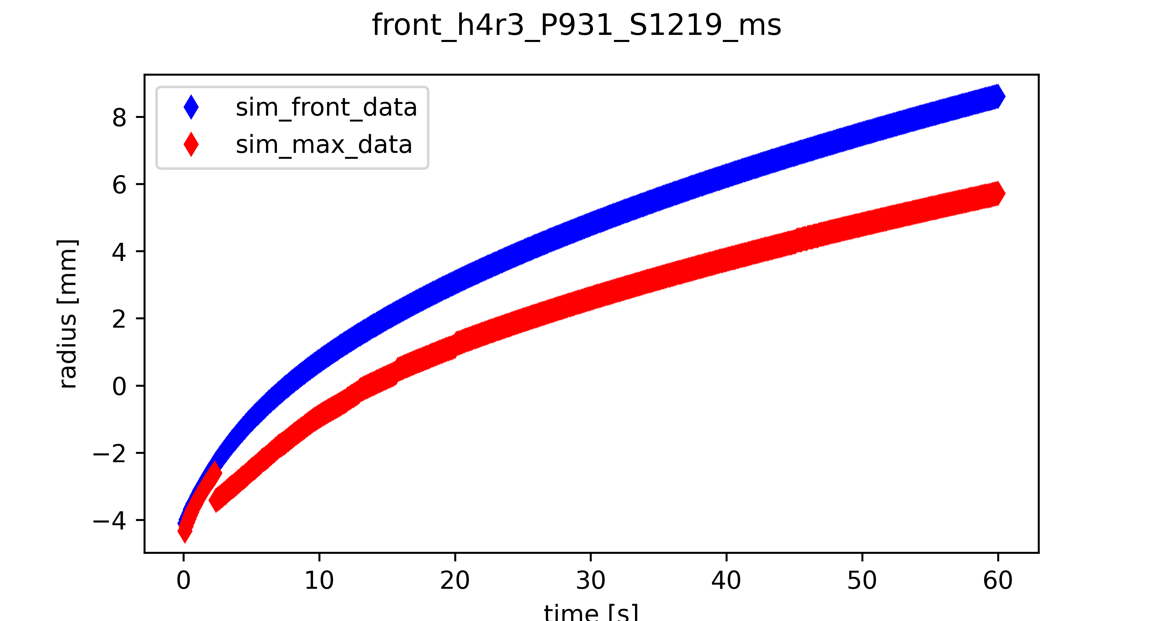
Resulting Variables
Front position
Front width

Slide 7
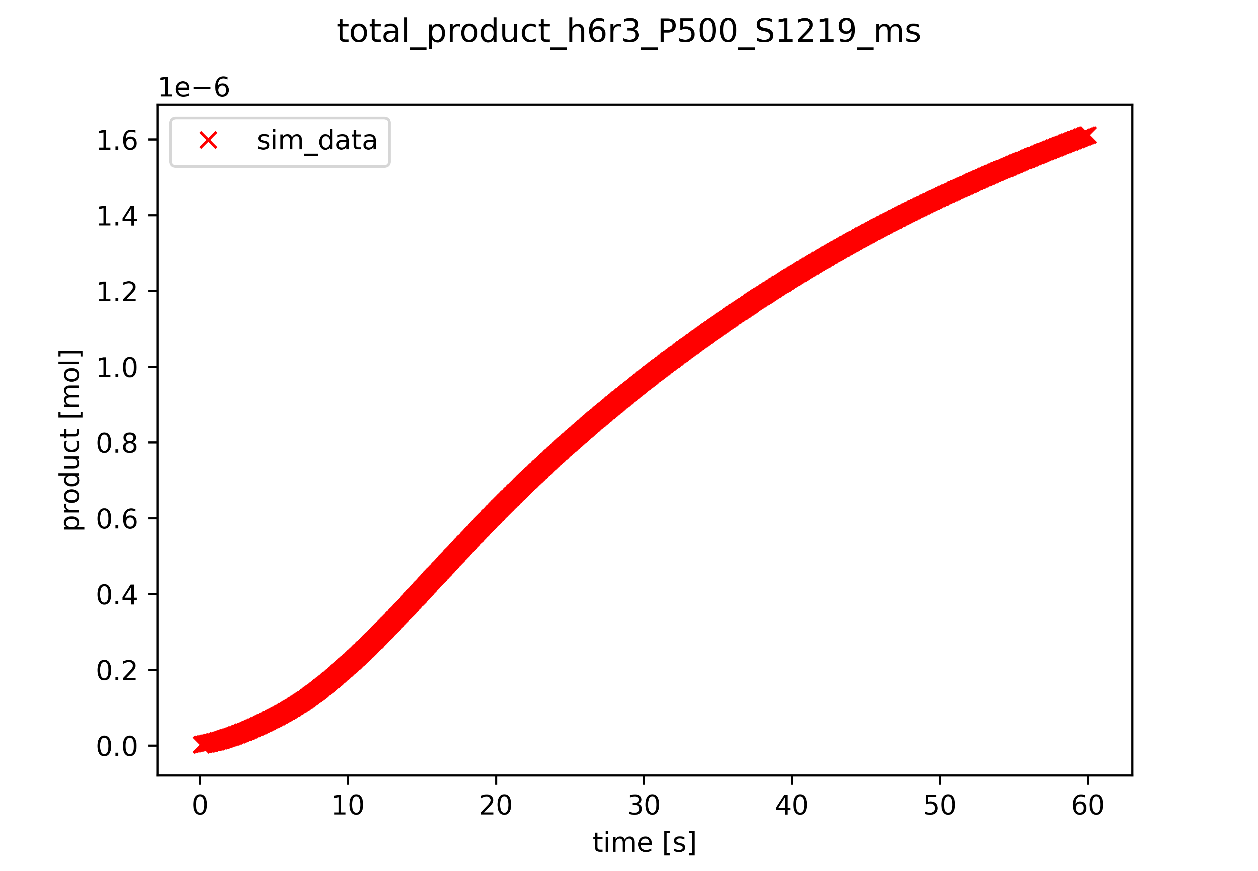
Resulting Variables

Slide 8
Steps to do
Setup cases for most extreme conditions
  Highest input velocities
  Lowest Diffusion coefficient
Adapt mesh size until results look fine
Run all cases
Create combined plots for cases to be compared
Finish Writing

Slide 9
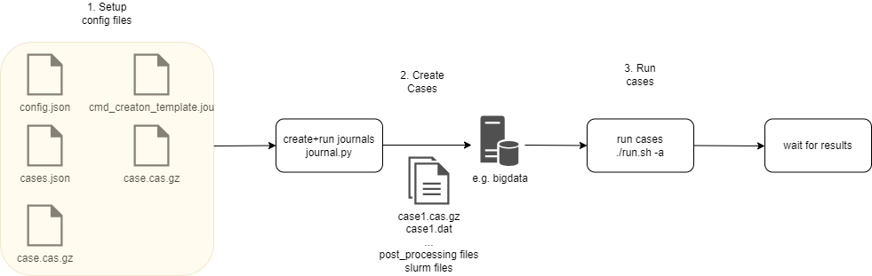
Ansys Fluent automation

Slide 10
Thank you for your attention

